Slide 1
DSA Self-Paced
6 Week summer training
Airline Reservation System
Name : Akash Tripathi
Regd No. : 12101602
Course Code : CSE 443

Slide 2
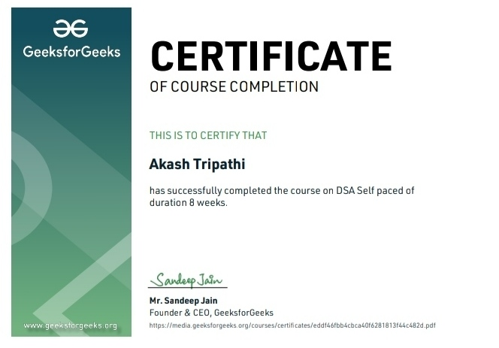
Certificates
Link : Profile Section

Slide 3
About Summer Training
The Airline Reservation System is a desktop application coded in a C++ programming language.
The project contains a functionality that allow user to book a passenger flight.
This project was created to help fasten the booking of each passenger flight.
This will make it easier for the employee to track the passenger flight details.

Slide 4
Organisation Information
With the idea of imparting programming knowledge, Mr. Sandeep Jain, an IIT Roorkee alumnus started a dream, GeeksforGeeks.
Whether programming excites you or you feel stifled, wondering how to prepare for interview questions or how to ace data structures and algorithms, GeeksforGeeks is a one-stop solution.
With every tick of time, they are adding arrows in our quiver. From articles on various computer science subjects to programming problems for practice, from basic to premium courses, from technologies to entrance examinations, they have been building ample content with superior quality.
In a short span, they have built a community of 1 Million+ Geeks around the world, 20,000+ Contributors and 500+ Campus Ambassadors in various colleges across the nation. Their success stories include a lot of students who benefitted in their placements and landed jobs at tech giants. Their vision is to build a gigantic network of geeks and there are only a fraction of it yet.

Slide 5
Why this course
This course is a complete package that helped me learn Data Structures and Algorithms from basic to an advanced level.
The course curriculum has been divided into 6 weeks where one can practice questions & attempt the assessment tests according to his own pace.
The course offers me a wealth of programming challenges that will help me to prepare for interviews with top-notch companies like Microsoft, Amazon, Adobe etc.
Data structures and algorithms (DSA) goes through solutions to standard problems in detail and gives you an insight into how efficient it is to use each one of them.
It also teaches you the science of evaluating the efficiency of an algorithm. This enables you to choose the best of various choices.

Slide 6
Why dsa is important
A data structure is a specialized format for organizing, processing, retrieving, and storing data.
Data structures make it easy for users to access the data they need and use it appropriately. In computer science and computer programming, a data structure can be chosen or designed to store data for the purpose of using it with different algorithms.
In some cases, the underlying operations of the algorithm are closely tied to the design of the data structure. Each data structure contains information about the values of the data, the relationships between the data, and - in some cases - the functions that can be applied to the data.
Without these tools, it would be practically impossible to collect, process, and analyze all the data that is generated by computers around the world. In data structures, we learn how to organize data using various techniques, such as arrays and linked lists. In algorithms, we study the various ways that computers can be programmed to solve problems

Slide 7
Technology learnt
Learn Data Structures and Algorithms from basic to an advanced level
Learn Topic-wise implementation of different Data Structures & Algorithms as follows
Analysis of common loops | Analysis of recursion
Space Complexity | Arrays and Strings
Searching and sorting | hashing
Linked list | Stacks, Queues and Deque
Binary search tree | Heap
Graphs | Greedy
Backtracking and dynamic programming | Segment Tree

Slide 8
Project description
The Airline Reservation System was developed using only C++ programming language. This system is a user-friendly kind of system that can be easily modified. The system provide you an efficient way for booking a flight ticket. It will give you a convenient way to to record all the passenger information. By using this system, it will lessen the problem for booking a wrong flight detail to the passenger.
Features
Can make reservation and cancel it
Search passenger and change reservation
Print a list of passenger and status report
Passenger can order meal according to their need

Slide 9
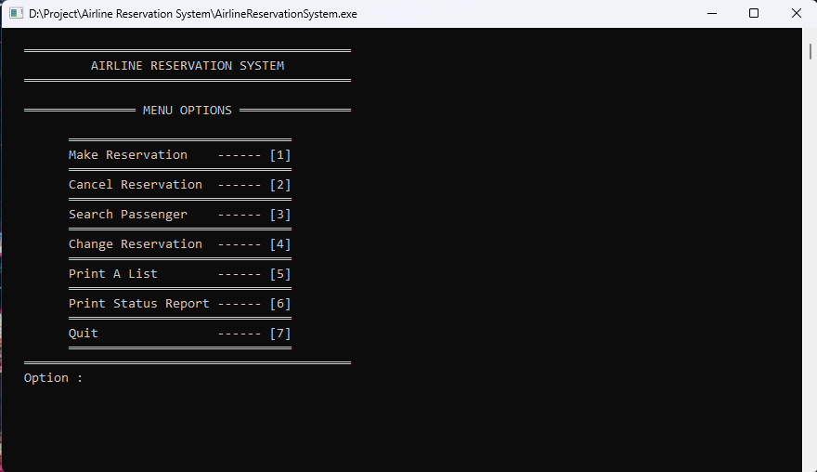
implementation

Slide 10
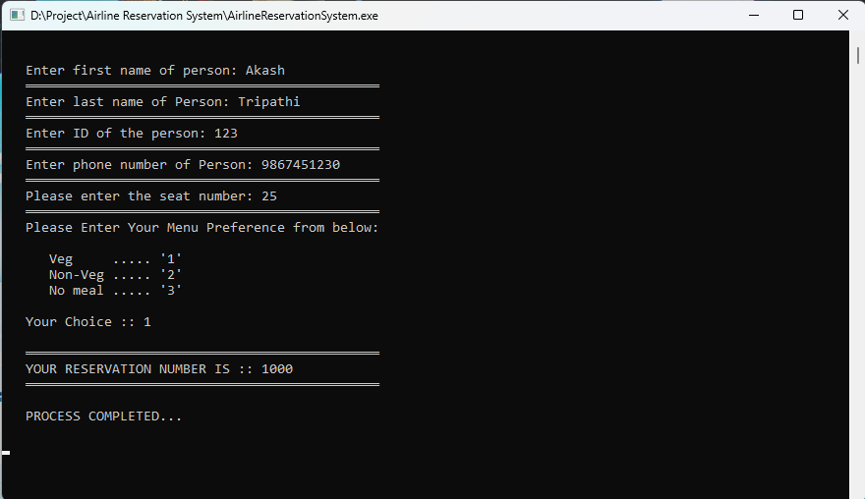
Make reservation

Slide 11
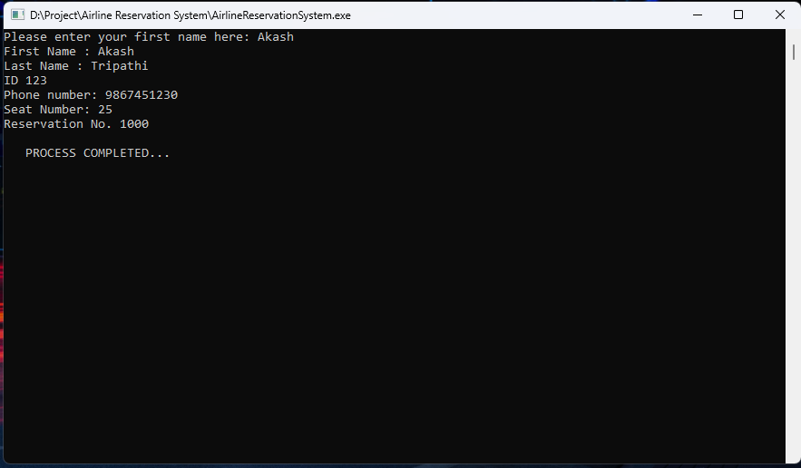
Search passenger

Slide 12
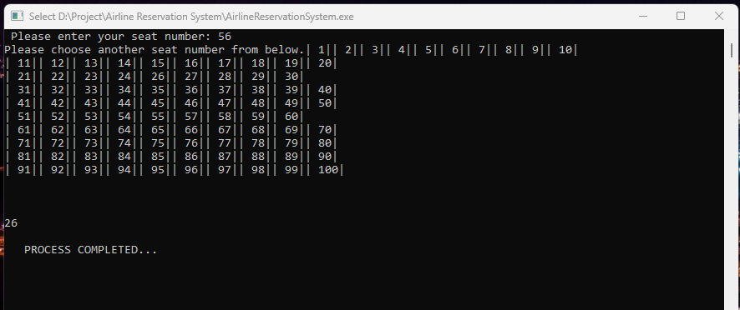
Change reservation

Slide 13
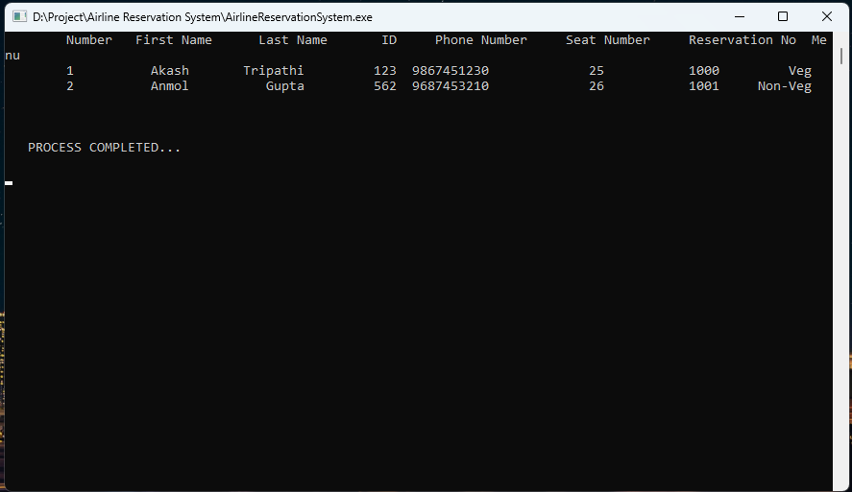
Print A list

Slide 14
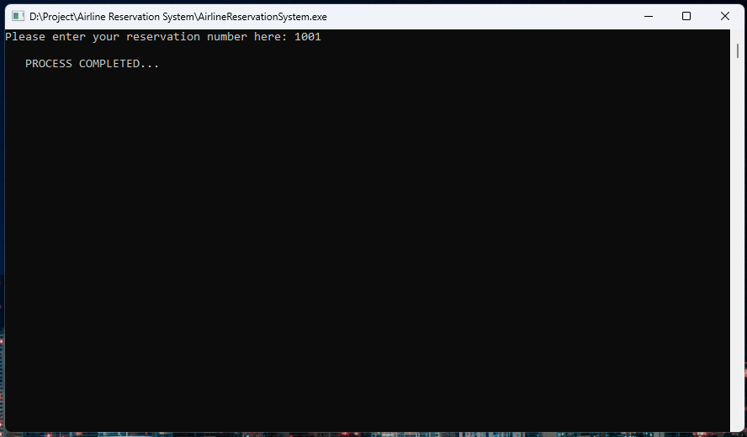
Cancel reservation

Slide 15
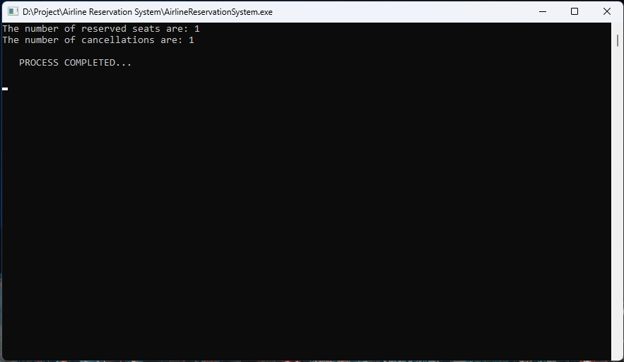
Print status report

Slide 16


